Slide 1
Notes:
What do you remember about last November? The dodgers won the world series? the US treasury minted its last penny? What I remember is this: we had all been experimenting with AI coding tools for awhile, but no one was quite to the point of blindly trusting the models’ code. In November, something changed. Suddenly, the models were writing code that could be trusted.
That’s a huge moment.

Slide 2
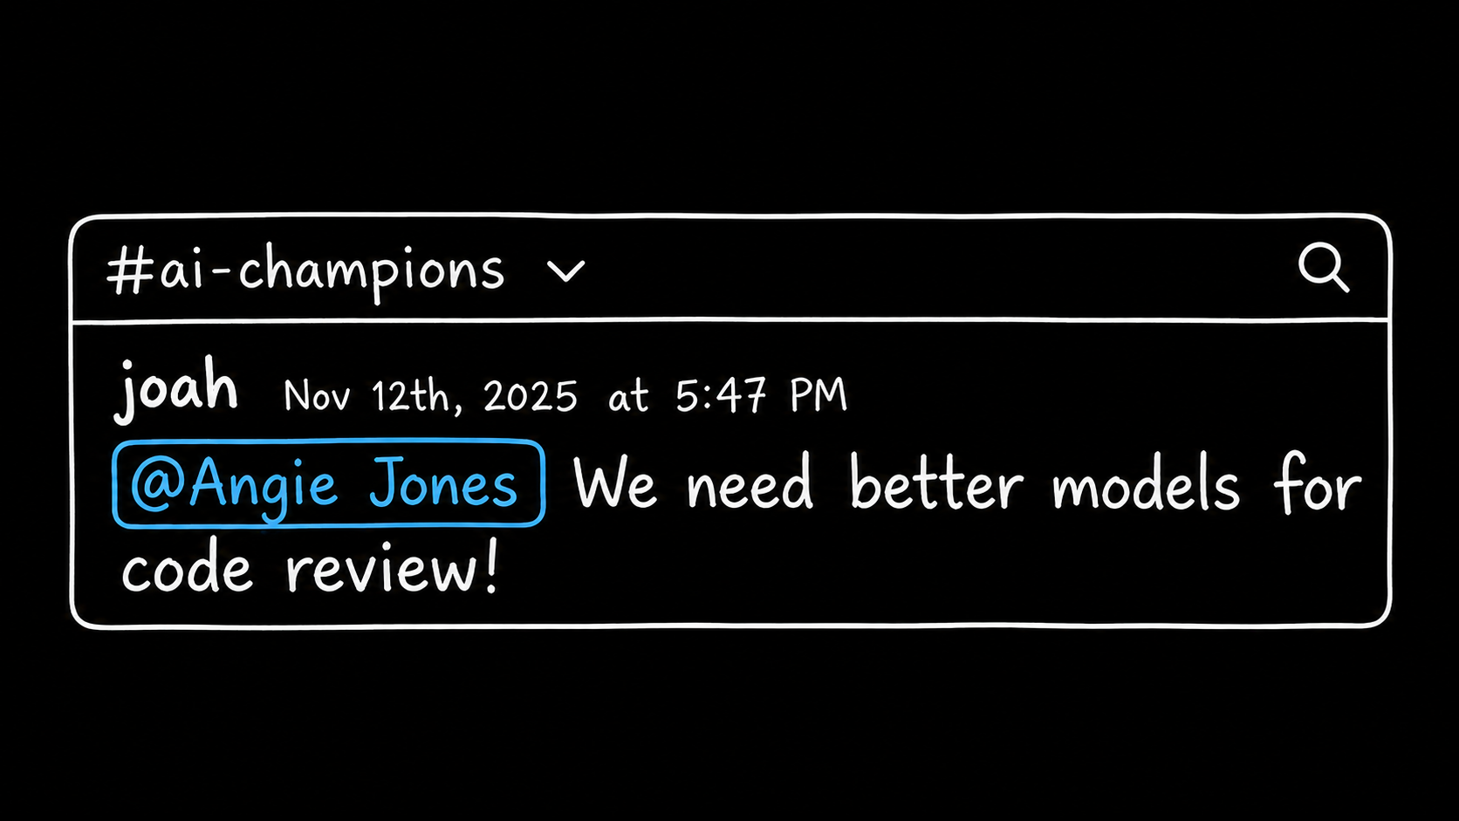
Notes:
Earlier in 2025, we had built our own AI code reviewer, but we were considering turning it off because it was constantly noisy and incorrect. It was viewed as an experiment and was pressured to use cheap models and reduce run costs. we had coworkers running scripts that deleted all the reviewer’s comments because they were so bad. But as soon as we saw GPT 5 1’s Swee Bench scores, we knew that we were in trouble. Agent-written code was finally better than human written code, and it was written in a matter of second instead of days. It was clear that our new challenge would be automating validation in the same way that we had automated production.
Opus 4 5 came out only a couple weeks later and blew away GPT’s scores. It was official - the bottleneck of writing trustable code was gone - now our job was to build the systems that allow us to verify that it’s actually correct.

Slide 3
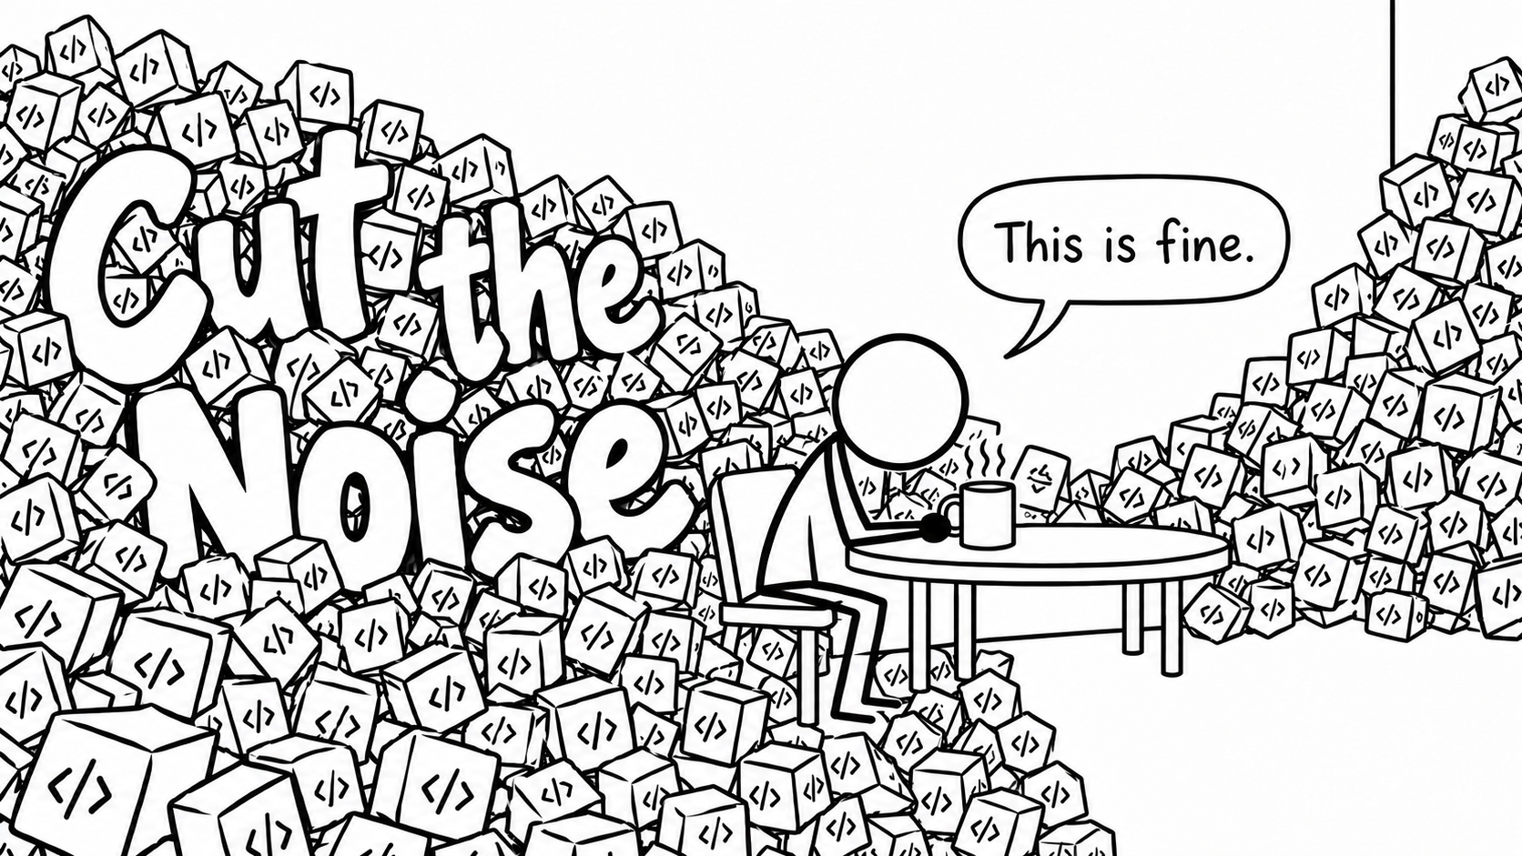





Joah Gerstenberg
TL, Risk-based Agent Autonomy
AGNTCon · San Jose · October 2026
Notes:
Good afternoon! My name is Joah Gerstenberg. I am a tech lead at Block focused on Risk-based Agent Autonomy. That’s a fancy way of saying that I am building intelligent agents that we can trust to safely make changes to production without asking for help. While working in this area, What I and so many others have realized is that if we can’t trust the code our agents are writing, code verification will always be the bottleneck in the software factory.
Linters, tests, and compilers will only get you so far - if we actually want to trust that agent-written code is achieving what we expected it to while not introducing new bugs or vulnerabilities, we have to infuse verification intelligence in the same way that we have infused authorship with intelligence.
This talk is about what we’ve learned this year while building a reviewer that we actually trust. Hopefully that’s the talk you’re here to see :)

Slide 4
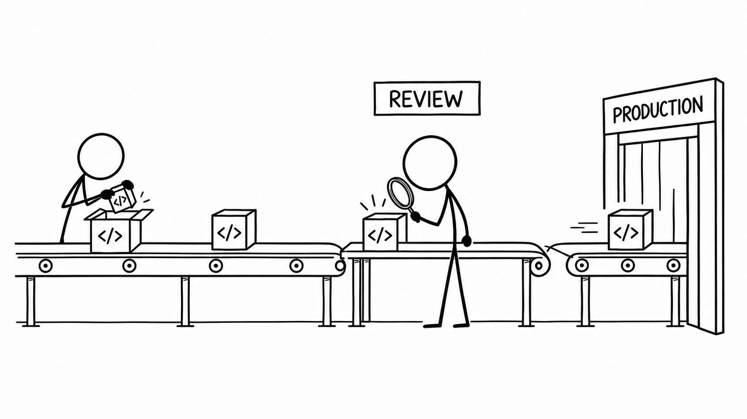
Notes:
Ah, the good ole days. (For the vibecoders in the room, this is what Claude is remembering when it says it’ll take six weeks to implement your authentication.) Just a year ago, we took time to write and verify every line of every module. It felt like putting a puzzle together. I could name every line of my library from memory. Once it was done, I handed it off to another engineer, who would read and verify my work. We got to learn from each other, and we each got better at the craft of programming. We would take months to plan, build, and verify features before shipping them.

Slide 5
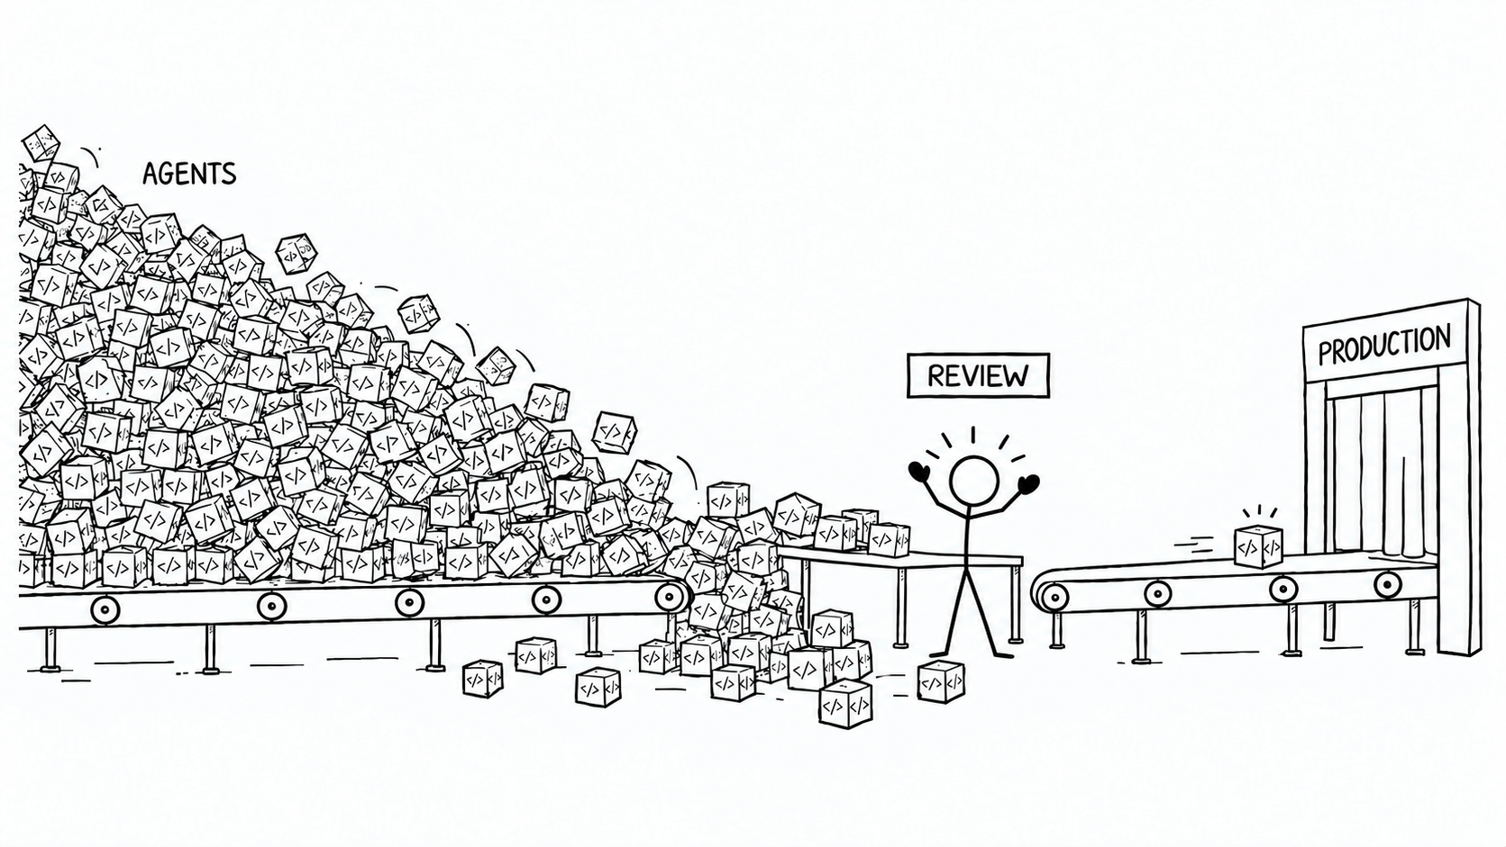
Notes:
Then the agents arrived. Suddenly, our review inboxes were flooded with changes written by bots that we weren’t sure if we could trust. We clearly couldn’t start shipping faster as long as we were still being asked to give our stamp of approval on every change that went out. We weren’t willing to take on the risks of exposing our customers and simply start shipping everything that our agents produced. Production had increased, and now review was the new rate limit.

Slide 6
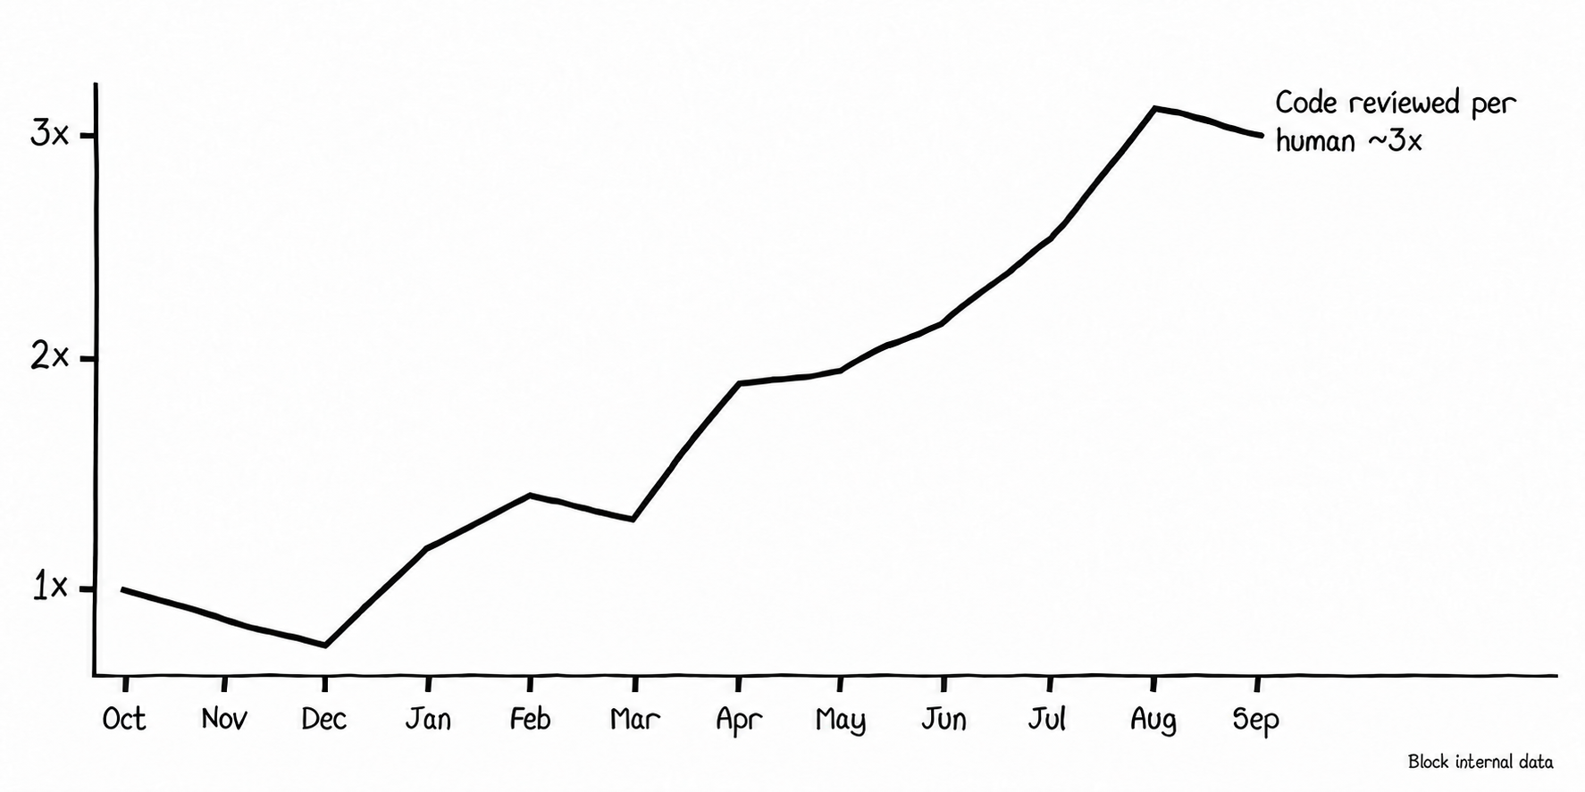
Notes:
Compared to a year ago, the typical reviewer at Block is reviewing about three times as many lines of code. whether we like it or not, we are each delegating trust to the agents writing and reviewing code alongside us.
With this much code being written, reviewed, and shipped, human attention is spread thin and reviewing code has transformed from a practice of craft to a ritual of trust. Do I trust that my teammate is following the plan we agreed to? Do I trust that their agents are considering the bigger picture than this prompt?

Slide 7
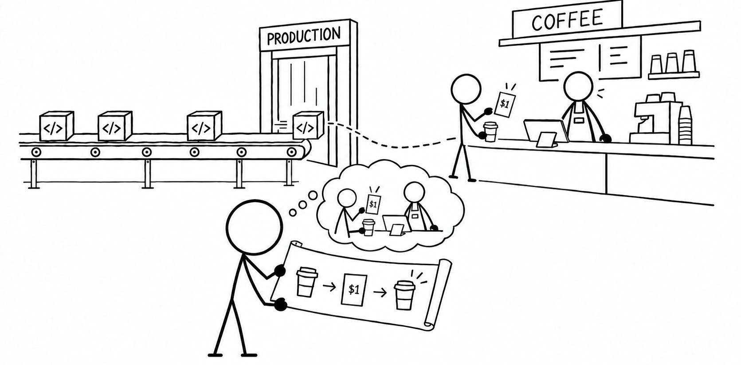
Notes:
I began my career as a UX engineer. For over a decade, I worked closely with product managers and designers to get deeply familiar with our customers’ needs and build something that delivered an experience that I was proud of. Working on the frontend, it’s easy to see that the code was always a means to an end. My job wasn’t to deliver a typescript library that I knew backwards and frontwards, I needed to make sure that when someone went to the local coffee shop, they didn’t get double-charged for their espresso.
With agents writing code, having a firm grasp on the customer experience is now the most important part of our job.

Slide 8
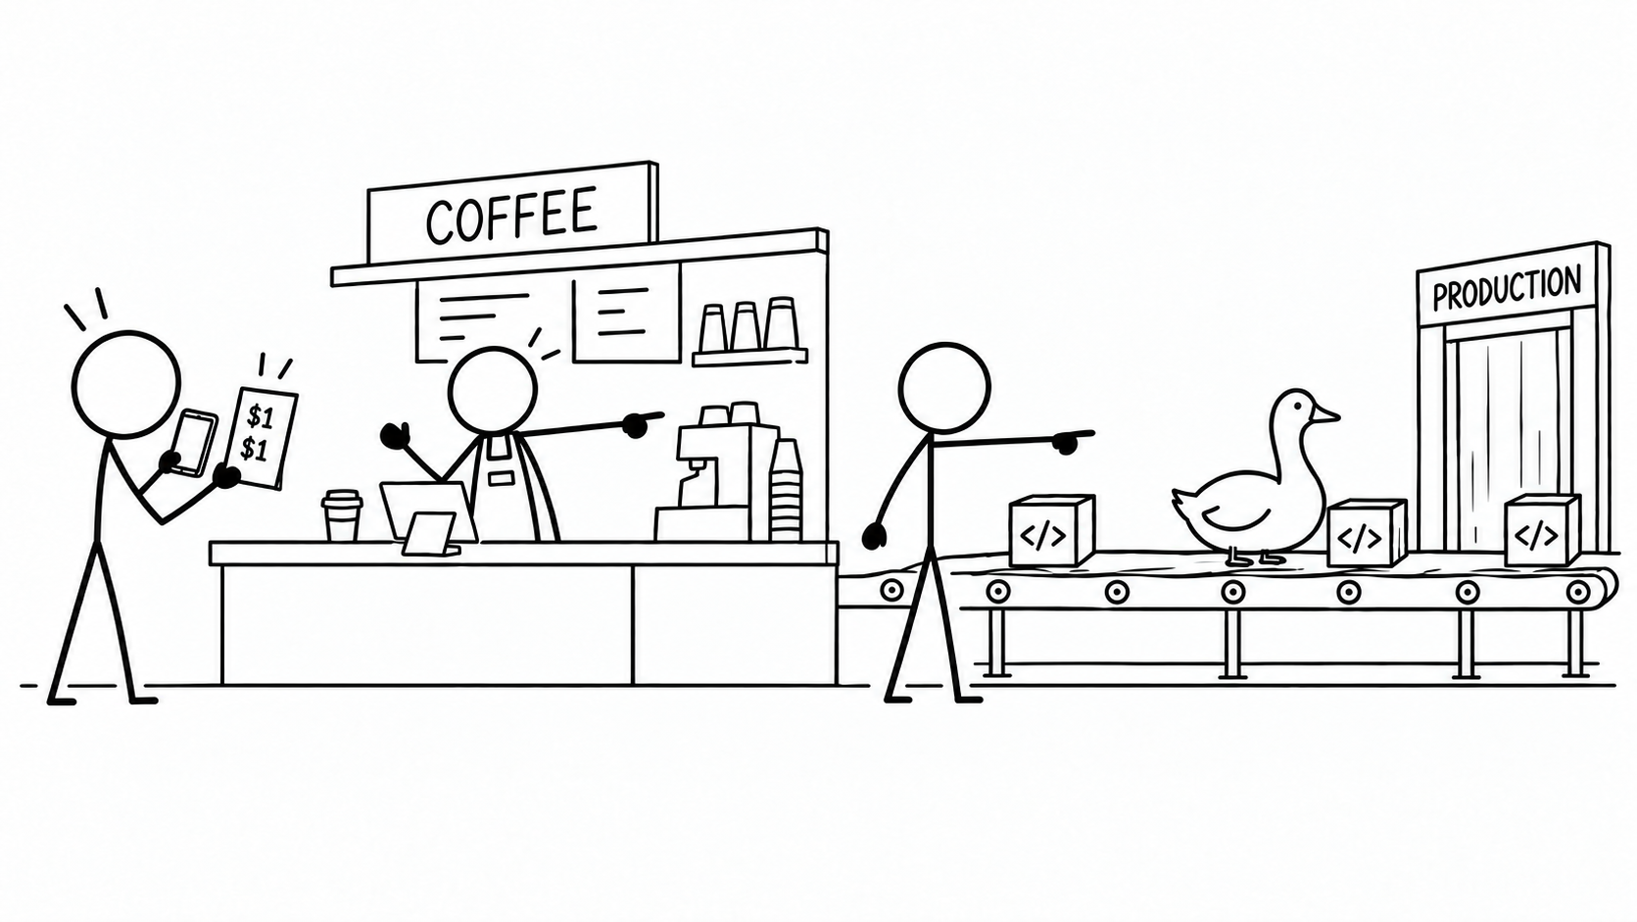
Notes:
Building with taste and staying closely in touch with your customers is now more critical than ever.
The code was never the goal. The goal was building an experience that we were willing to sign our names to. At the end of the day, we still hold responsibility for the outputs of our agents, so how can we build something that we trust to protect our vision for our customer experience?

Slide 9
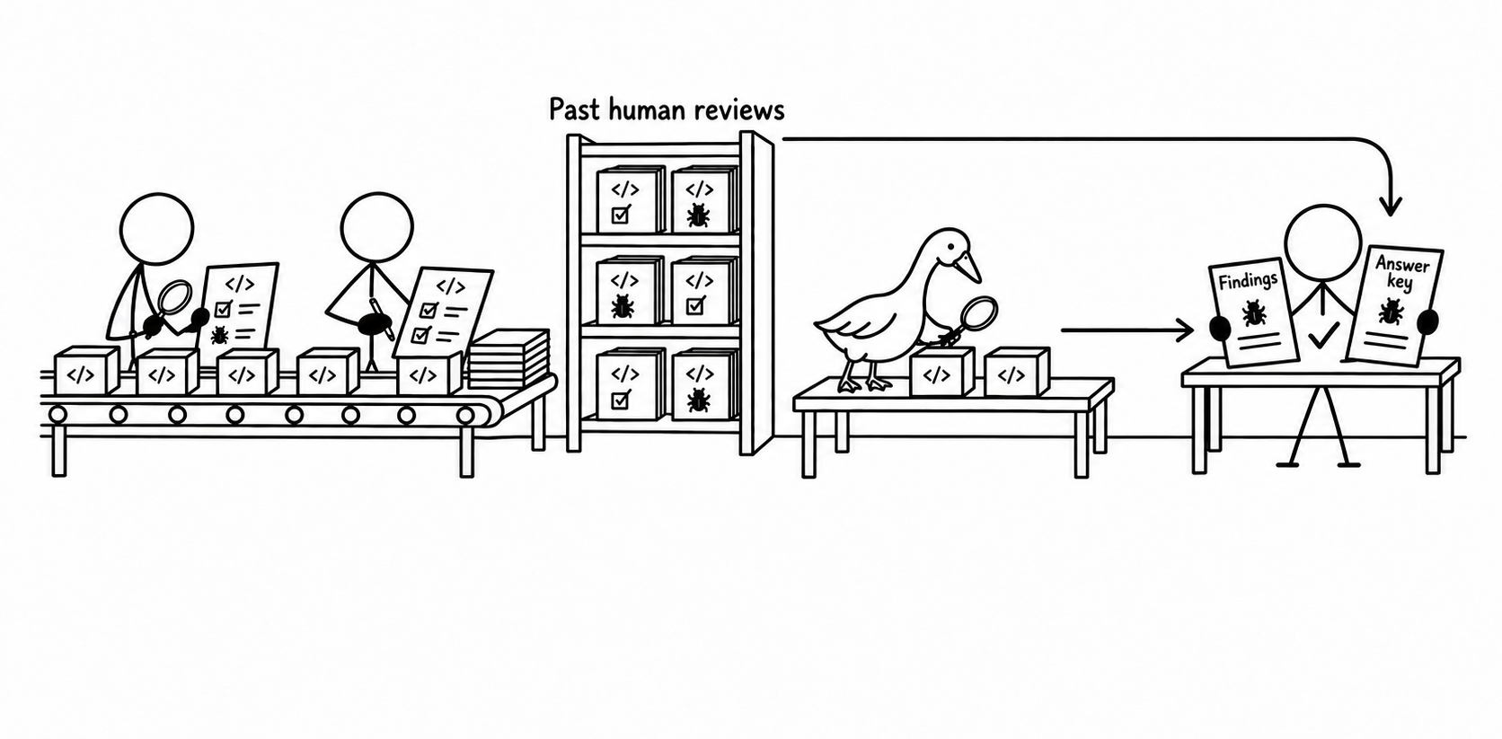
Calibrate your reviewer to past human reviews
DoorDash Engineering Blog · 2026
Notes:
The starting place for measuring an agent’s performance is simply by comparing its behavior against an answer key written by humans. For our own golden review set, we’ve collected hundreds of high-quality code reviews from subject matter experts to measure our reviewer’s performance against. This is a great way to ensure we’re building a reviewer that is capable of catching the issues that humans have found, but the reality is that the models operate on an entirely different level, and their findings will far surpass what humans have ever been capable of.
Something that we have learned along the way is how important it is to treat inputs as inputs and outputs as outputs. The comments that we leave as human reviewers are an output of our “trace of thought” that we usually omit from the text we put into GitHub - human reviews are a good measuring stick to tell you how much you can trust a reviewer compared to a human, but using imperfect reviews to steer a model usually just makes it worse and more noisy.

Slide 10
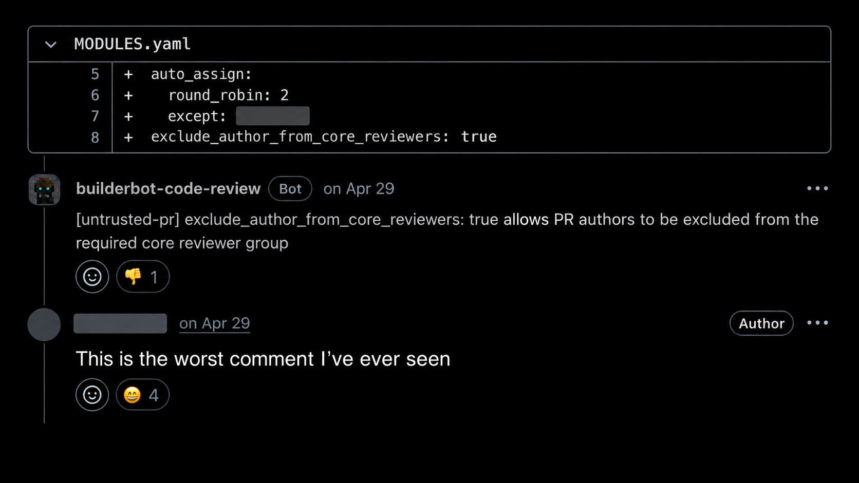
Block internal data
Notes:
We actually spent a long time going down this path, and built a whole agentic pipeline to read and learn from past human reviews. We thought it was working well until one day in April, we fixed a bug that was preventing our reviewer from sharing all of the things it had learned from past human reviews, and it got really noisy really quickly.
Don’t make the same mistake as us - this prompted us to shut down the reviewer and rebuild it again from scratch.

Slide 11
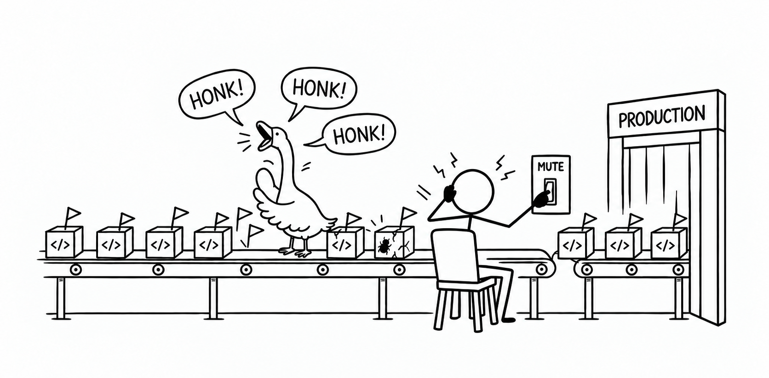
A reviewer that’s muted catches nothing
DoorDash / Figma · 2026
Notes:
We had learned how important setting a very high bar for precision is, instead of focusing on maximizing for recall.
A couple weeks later, two engineers at DoorDash shared that they had found the same thing - they had also rebuilt their reviewer to prioritize minimizing false positives instead of focusing on minimizing false negatives. Like them, we saw how critical it was to invest in this piece of our infrastructure, and we were learning again how easy it was to get muted if we didn’t keep a high bar for human attention.
Later in the summer, Figma’s engineers shared that they were also setting a minimum bar for their reviewer’s precision! They weren’t letting their reviewer post anything until they could prove that it was right at least 70% of the time.

Slide 12
OFFLINE EVALS
Compare findings with an answer key
ONLINE EVALS
Observe what happens in production
Notes:
I have a hunch that all of our work is going to continue looking more and more like the work of a machine learning engineer..
So let’s quickly define some terms. If you want to evaluate the performance of an agentic system, you should aim to measure its performance OFFline before you bring it ONline. Offline evaluations are those tests I was referring to a bit ago - they let you measure an agent’s performance against an answer key of human-labeled data. Once you have confidence in its behavior, you are ready to take it online and begin monitoring how it performs live.

Slide 13
PRECISION
Valid findings
────────────
All findings
RECALL
Known defects found
────────────
All known defects
Notes:
A system’s precision allows you to measure true positives - what percentage of its findings are legitimate, and how many are just noise?
for example, if a reviewer posted 10 findings, but 3 was wrong, it would have 70% precision
Likewise, recall allows you to measure how many of the total findings we caught - how many of the real vulnerabilities did we catch?
for example, if a reviewer posted 5 findings, out of 10 possible findings, it would have 50% recall

Slide 14
ADDRESS RATE
Findings acted on
────────────
All settled findings
CHANGE FAIL RATE
Changes from findings
later fixed or reverted
────────────
All changes made
from findings
Notes:
Once a reviewer is running in production, you can begin measuring how many of its findings are actually accepted by humans, and monitoring how often a recommended change needs to be reverted.
Evals like these need to lead the conversation when building agentic systems. If you aren’t able to prove that your agents are doing what you expect them to be doing, you have missed a step in your design.

Slide 15
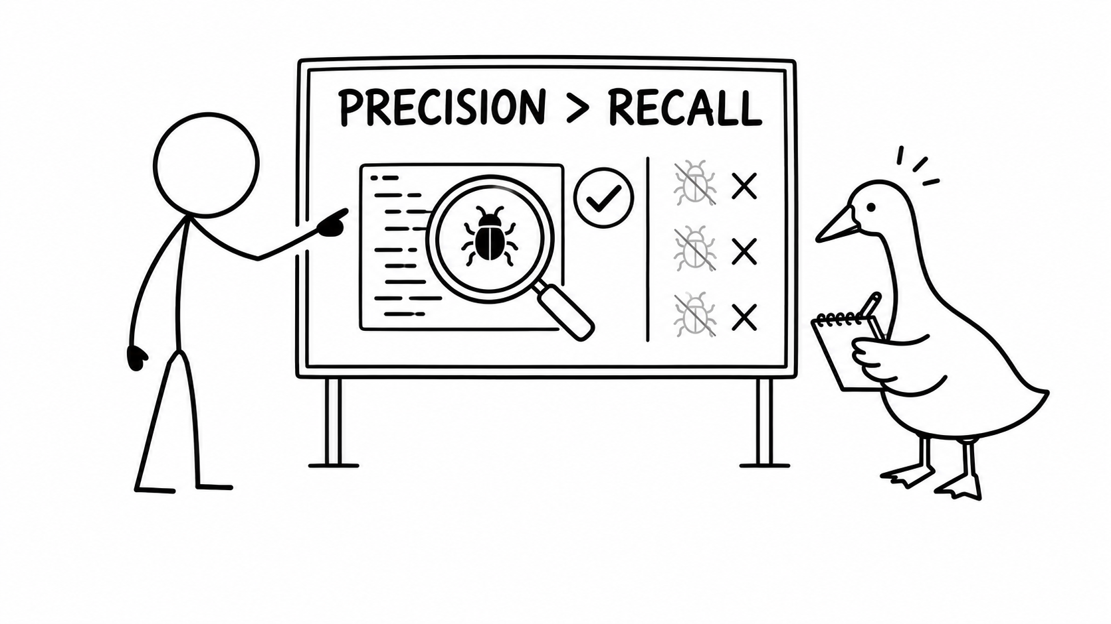
Prioritize precision over recall
OpenAI Alignment Blog · 2025
Notes:
What we had been learning, alongside many others in our industry, was how important it was to build a system that cut the noise, and ensure that our review was staying quiet when it had nothing to say. It turns out OpenAI had written about this months before we got here on their alignment blog - they shared that if you want to build a code reviewer that is usable, optimizing for precision is far more important than optimizing for recall.
While we need to know that our reviewer is catching the highest severity issues, We have to refuse the urge to try and catch everything, and instead accept that some low severity issues will make it to production.

Slide 16
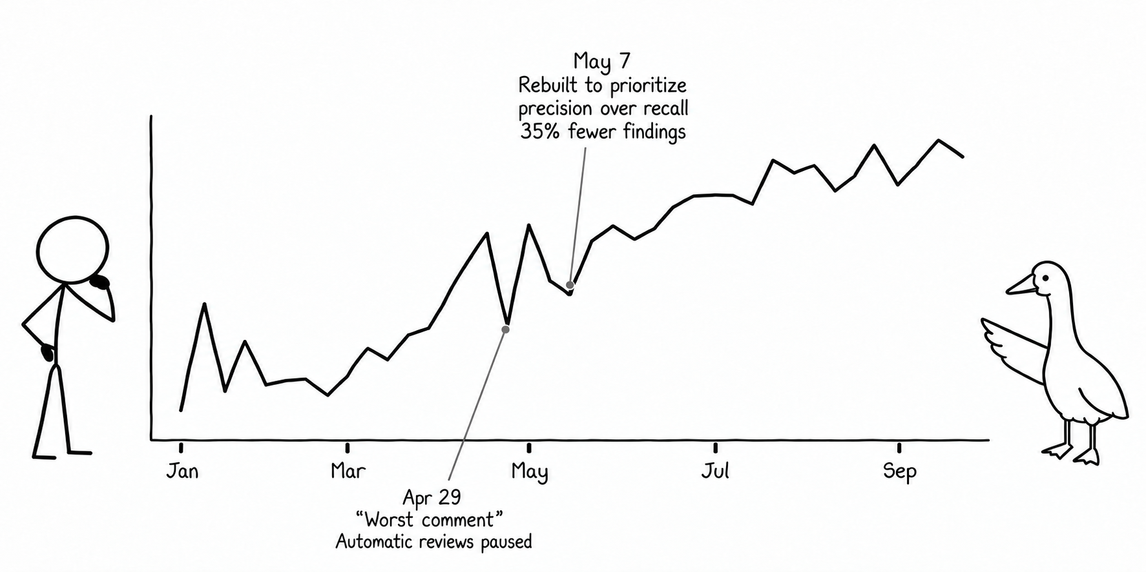
Online evals: address rate
Block internal data
Notes:
Once we started optimizing our reviewer to cut the noise and minimize false positives, we pretty quickly started seeing an increase in the number of comments that were taken seriously by humans. As soon as our engineers knew they could trust the reviewer to find real issues, it had earned enough trust to actually pay attention to. Over time, we saw the number of findings accepted and implemented by humans steadily growing.

Slide 17
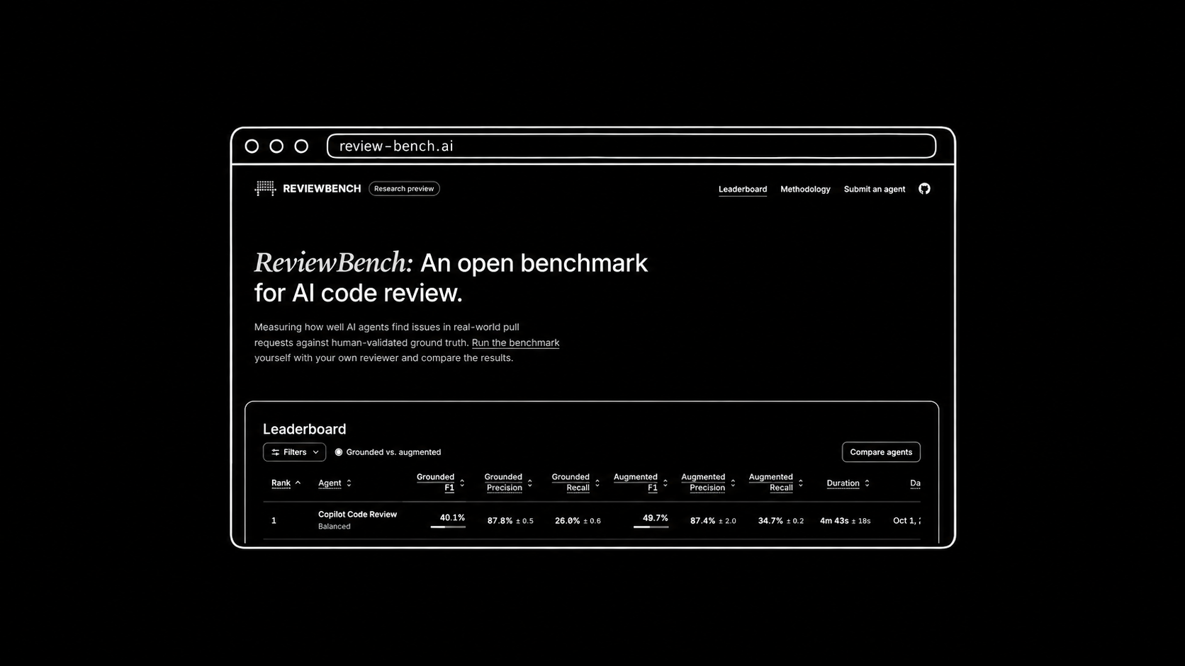
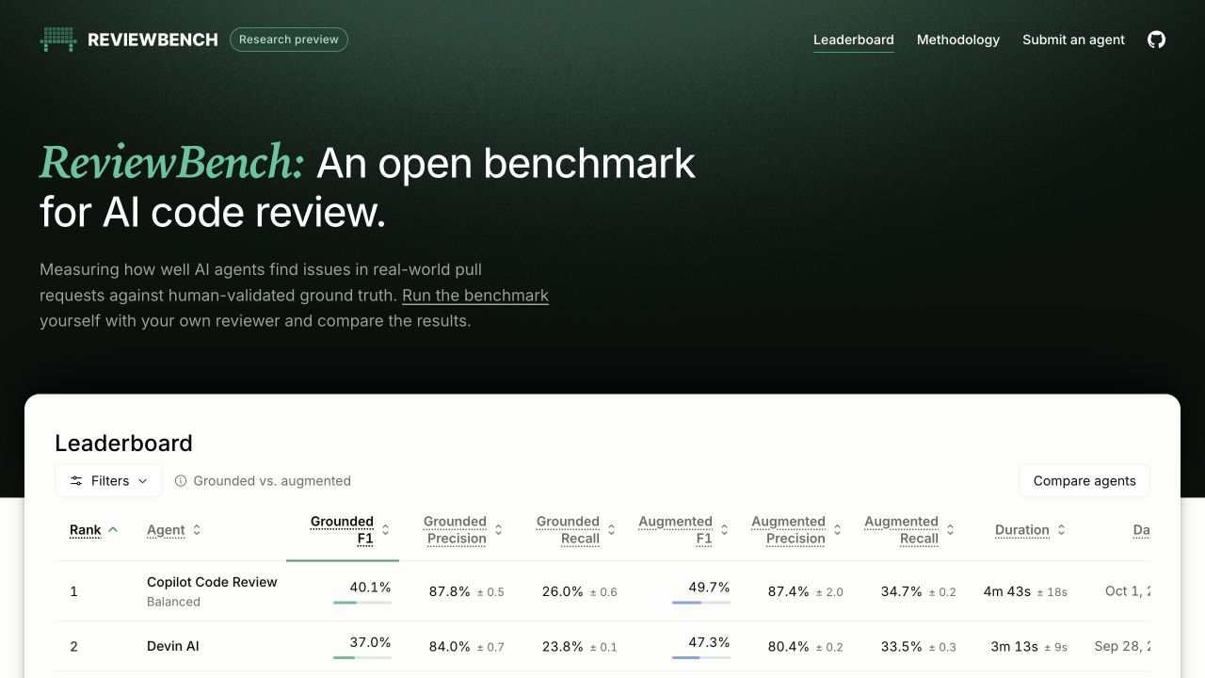
Notes:
A few weeks ago, some engineers at GitHub launched a new open code review benchmark called reviewbench, where we can all begin openly competing to see who can build the reviewer that can best optimize precision and recall. At the time of launch, GitHub’s own code reviewer was on top of the leaderboard, with 87.8% precision and 26% recall. Take that in: the best AI code reviewer you can buy right now is saying it will miss 74% of the vulnerabilities and bugs in a code change. Surely we can do better than that! With highscores starting this low, this area has a ton of potential for growth looking into the future.
Even before reviewbench was available, we had spent a lot of time benchmarking our own reviewer against the industry leaders on this list. What we found surprised us:

Slide 18
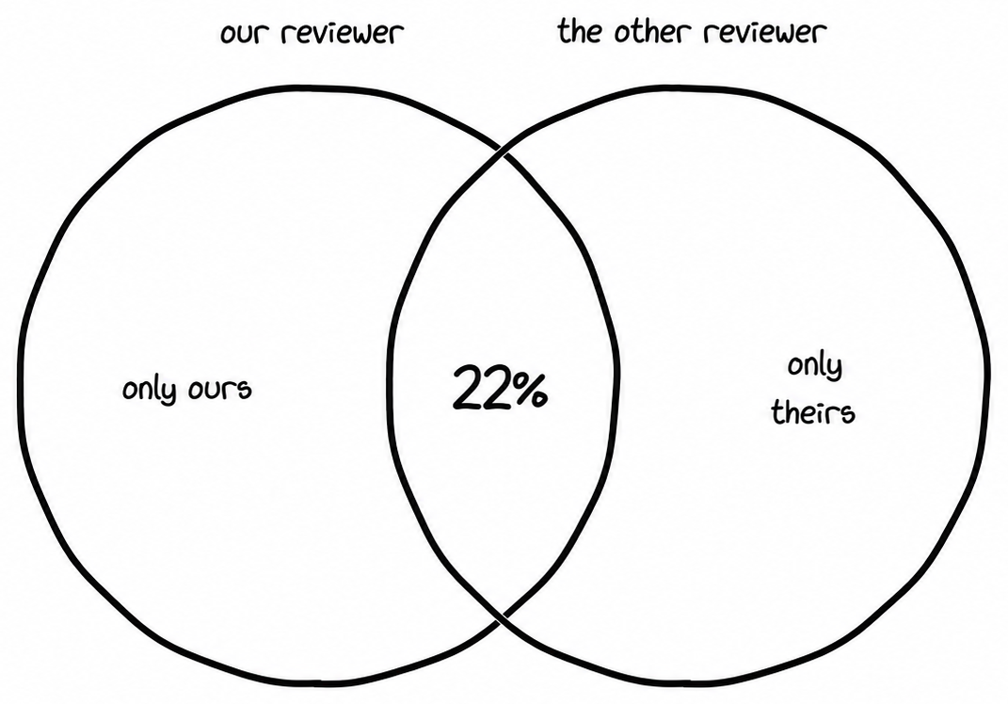
Block internal data
Notes:
With each reviewer finding only about a quarter of the bugs, the overlap between what our reviewer caught and what their reviewers caught was shockingly small. Only about one in five of our findings was shared between our results and theirs. All of the rest were unique to the reviewer. What do you do with this, then? Do you just run both reviewers forever and continue stacking them in order to get to 100% recall?

Slide 19
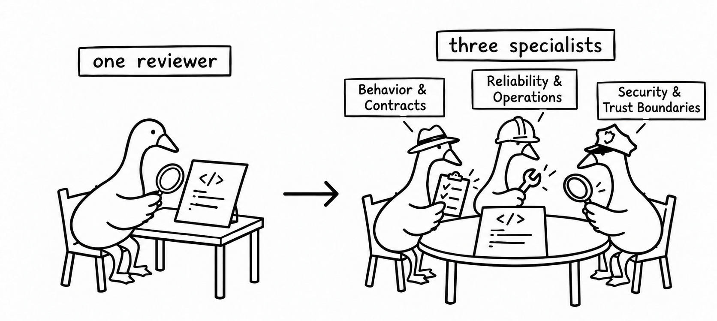
Three specialists improved recall by 11% over one reviewer
Block internal data
Notes:
Essentially, yes - that’s the strategy. We have found that increasing the number of quantity of reviewers and running them with a variety of prompts and models makes a big difference in increasing finding recall. Giving each reviewer a narrow scope of focus allows us to trust that we’re inspecting our code from multiple different perspectives, and using models that were trained on different materials makes it less likely that they’ll all catch the same thing
We found that moving from one reviewer to three improved recall by 11 points, without sacrificing precision!

Slide 20
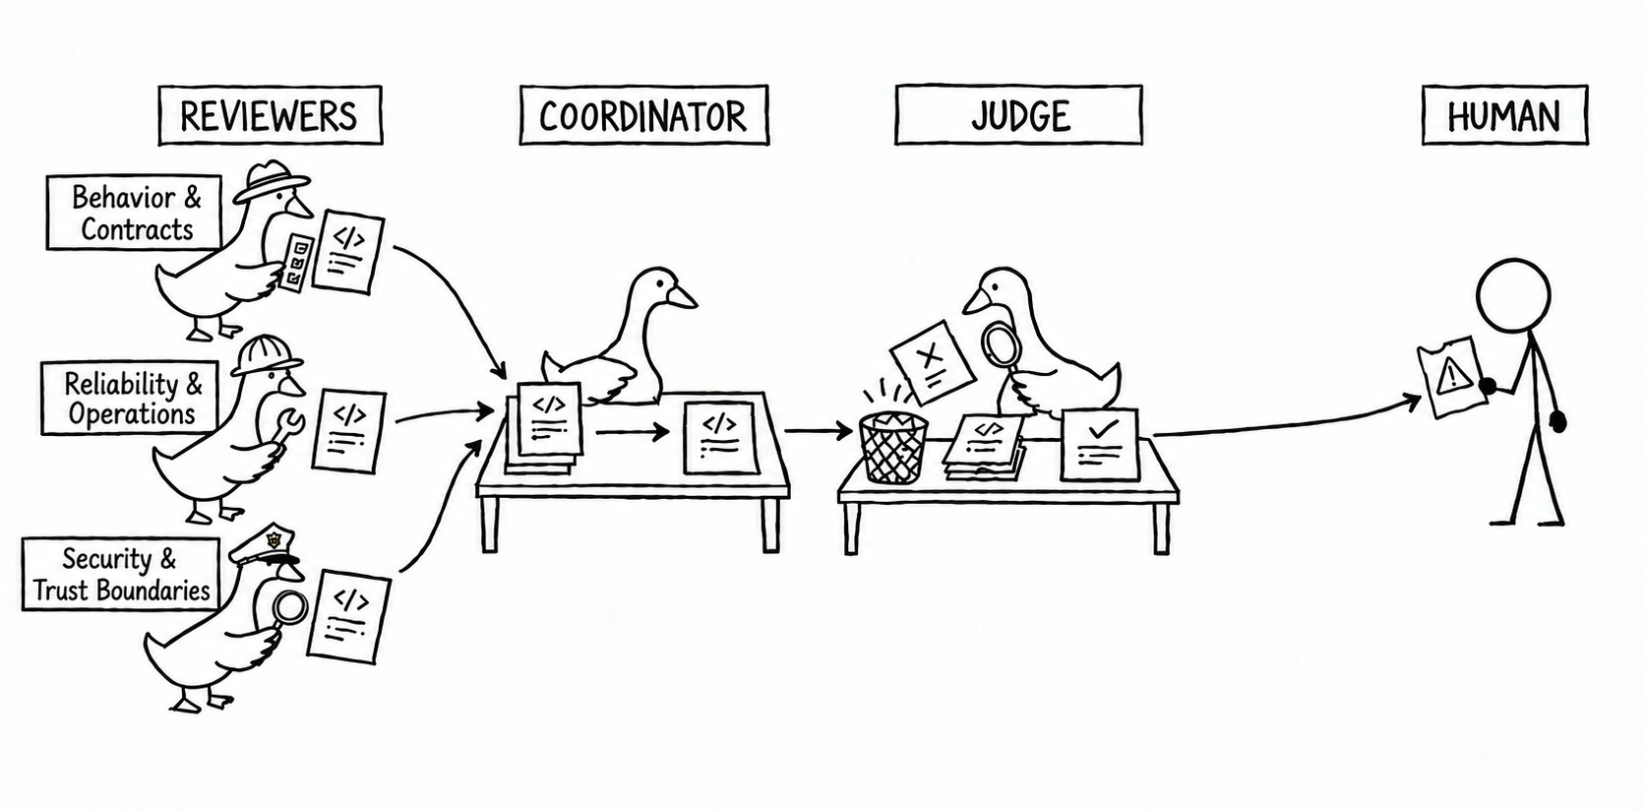
More layers increase precision, more reviewers increase recall
DoorDash / Figma · 2026
Notes:
Our reviewer agents go wide in their areas reporting up all of their findings and assigning each a confidence level.
We have them all report back to a coordinator agent, whose job it is to try to consolidate and disprove each of the findings before passing them on. We give our coordinator access to read feature flags, other repositories, and even slack to try to disprove the findings that our reviewers bring it. The coordinator hands its findings off to a judge who takes a final look at all of the dropped findings to verify that we didn’t toss out something important. Only the findings that make it through the full chain ever get shown to humans.
After reviewbench launched, we open sourced a modified version of our internal code reviewer to our GitHub. it follows this exact architecture using goose, Opus 5 5 and Sol 6 1, and beat out the copilot reviewer:

Slide 21
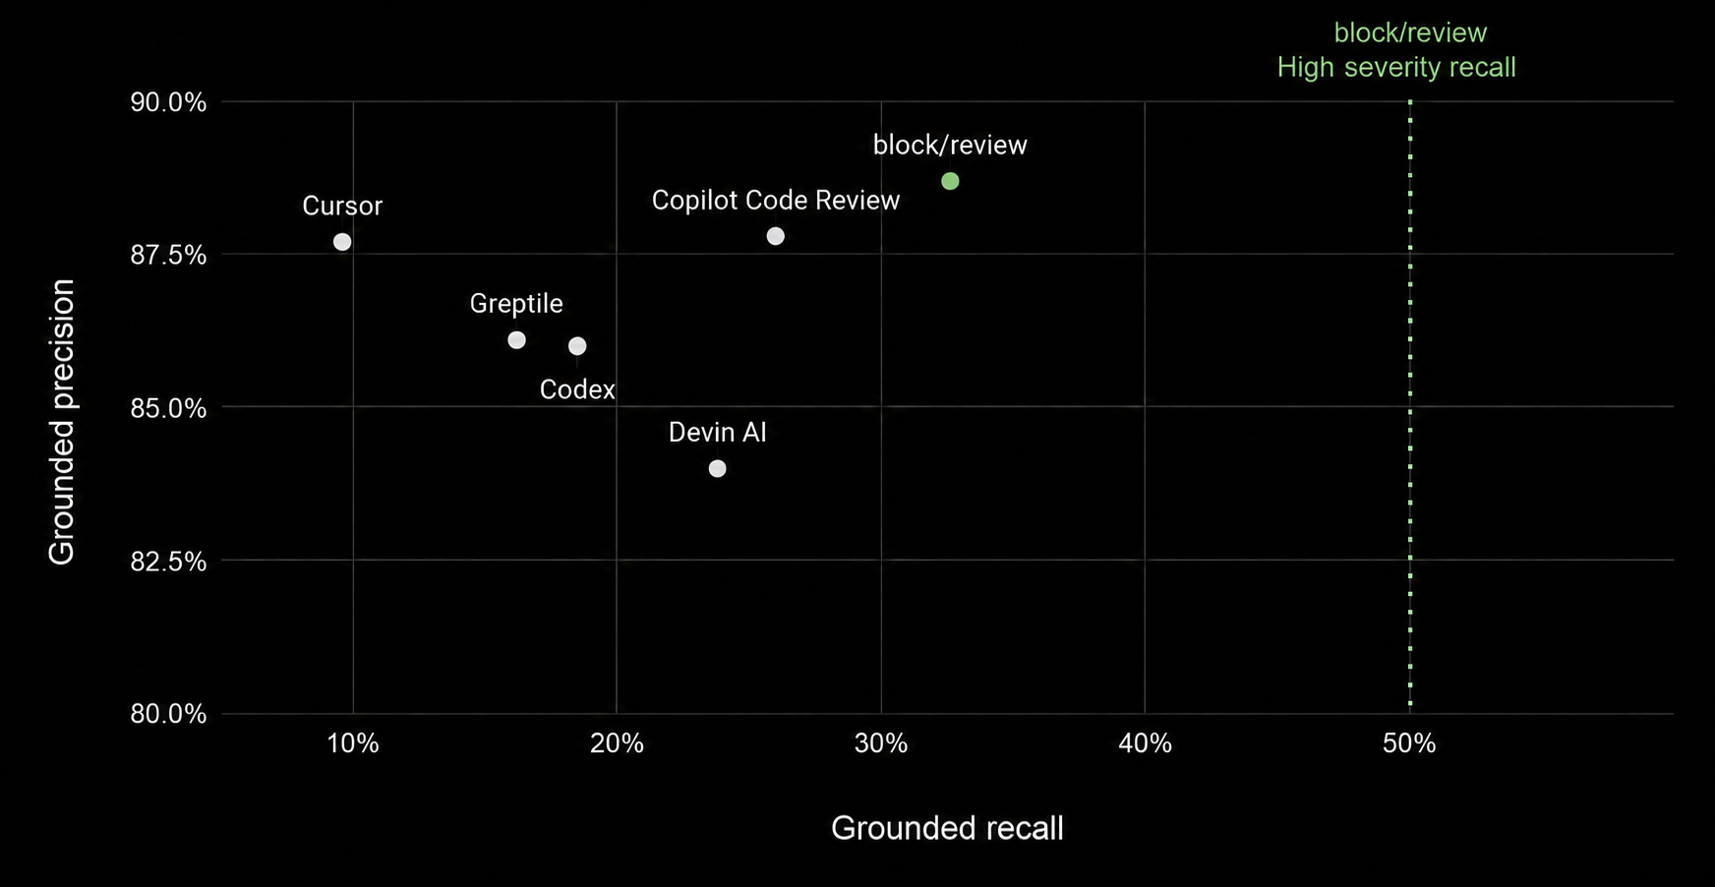
Grounded precision and recall
block/review - 88.7% / 32.6%
Notes:
This reviewer is running 6 review agents - 3 opus and 3 sol, filtered through a couple opus agents for precision. We got an 11% boost in recall for having more reviewers looking for findings, but when we put this in production, we found that people really still don’t like a reviewer that finds more issues as long as one in ten findings is still incorrect.
Even though review bench doesn’t share these numbers, what’s actually more interesting than total precision and recall filtering these down to only high- and medium- severity issues. For our reviewer, going from one to six reviewers increased high-severity issue recall by 18 points, from 32% to 50%.
The other data that isn’t shown on reviewbench today is cost. Getting reviews with precision and recall this high requires running multiple huge models in sequence - this is simply just not a scalable model for most businesses.

Slide 22
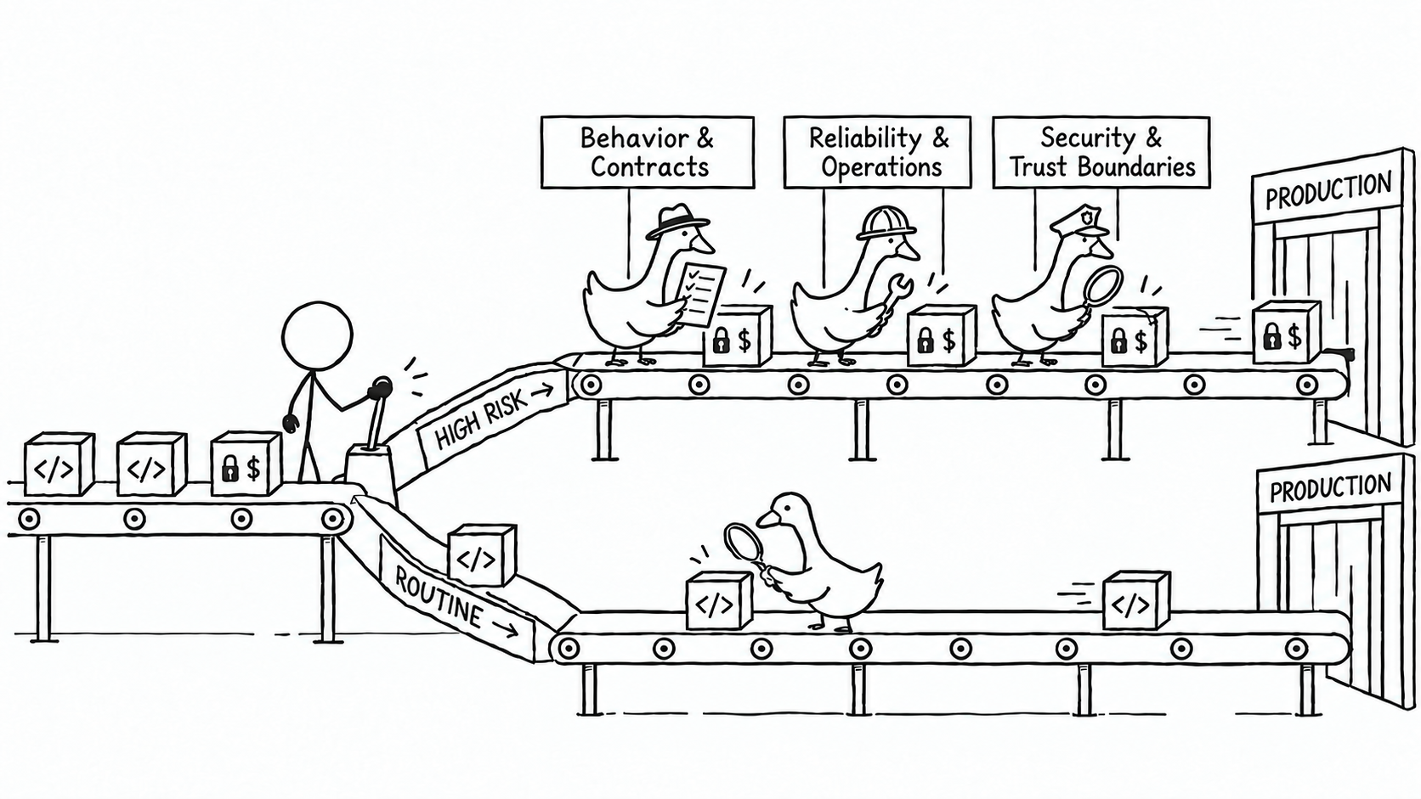
Risk-based review tiering
Meta · RADAR · 2026
Notes:
Like DoorDash and Figma, Meta also published a paper on automating code verification this summer. The method that their engineers describe hinges on accurately measuring the riskiness of a given change and adjusting the depth of the review to the risk. This is classic machine learning stuff - not another agent. Unlike our LLM reviewers, this model should be optimized for recall instead of precision, and produce a risk score based on the likelihood of the diff causing an issue needing to be fixed in production.
Given the output of the risk model, different teams within Meta can choose how they will route their code changes - and specify the depth of review they require for a given risk level
This makes a lot of sense! Just like we change the depth of our review when we review a coworker’s code, adding a new test shouldn’t require the same review depth as changing our ledgering contract.
We have our own version of this risk router inside our own agentic review system that identifies common risk patterns unique to our work. We flag changes that are privacy or security sensitive, touch money movement, or modify schemas to route them for a more thorough review. We have found that a risk-based review system like this makes it possible for autonomous agents to rapidly merge low-risk changes to improve our code, and this has become a critical piece of our development platform.

Slide 23
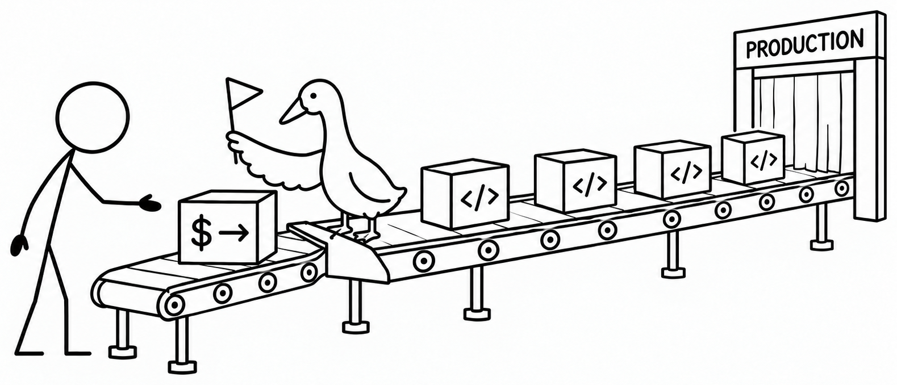
Irreversible changes
Public product claims
SOX compliance
Money movement
Personally identifying information
Humans only review the most sensitive changes
Notes:
Something else we’ve learned this year is that, no matter how much we push to prove the trustworthiness of our reviewer, for now there are still changes that people want to be able to look at for themselves. Some systems are still so hard to work on and costly to get wrong that reading the code is still the most efficient way to build confidence in an agent’s output.

Slide 24
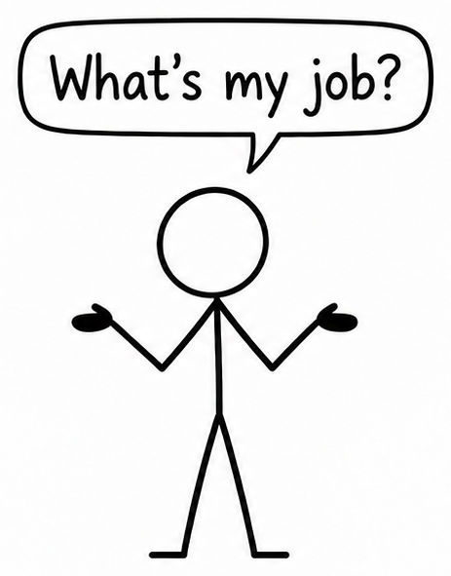
Notes:
But the models will continue getting better, and eventually Claude will know how to self-review and never write vulnerabilities to begin with. None of this even worked a year ago, and in a year from now it will all look even more different.
This is a heavy thing for many like me that have been writing software for a long time. It feels awful to hand over all of the puzzles we used to spend our time solving over to models that can solve them in a fraction of the time.
As the models get better, what is our job?

Slide 25
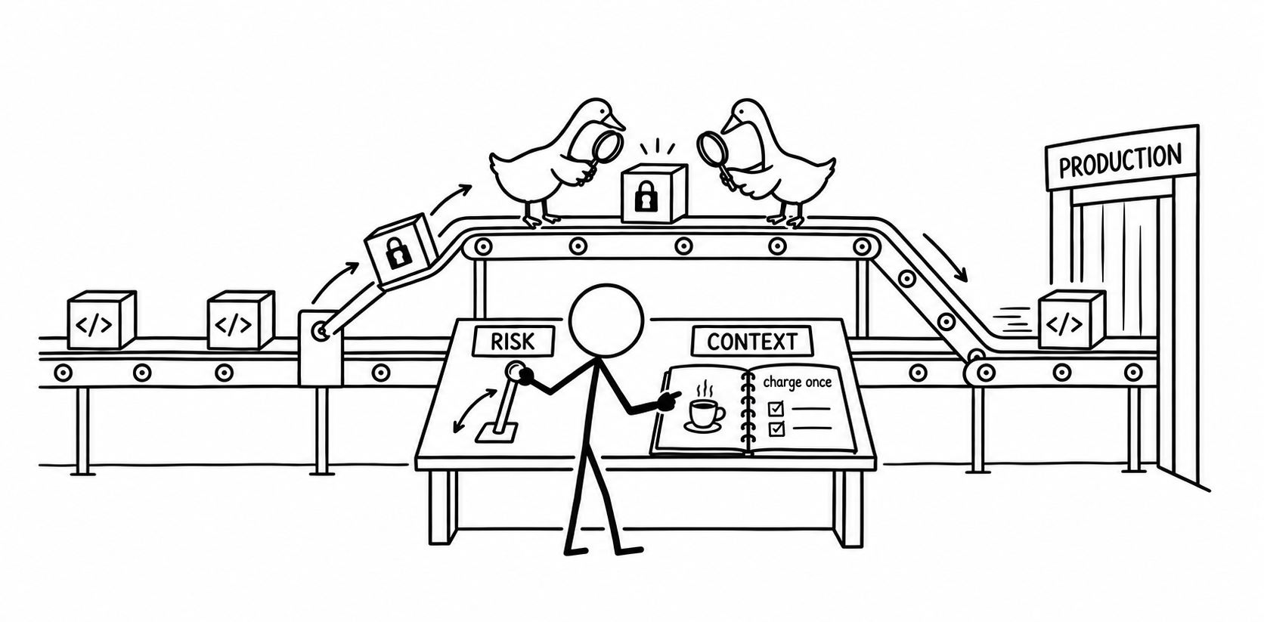
Align and contain
Notes:
The theme we see repeating is the importance of building alignment and containment for our agentic systems.
Our agents are able to align with our goals once we have given them enough context to see the picture of where we’re going. Making the goals of your business legible to your agents enables them to see when things are going off track.
This includes giving your agents access to systems like your team messages, issue tracker, and experimentation service. Your reviewers should be capable of referencing context from all of your systems to build an accurate picture of the world before recommending a change.
Once our agents have the context of goals, we must thoughtfully consider how we can contain their impact so we’re able to verify that they are achieving those goals in aligned ways.
Now that agents are writing all of our code, a scalable risk-based agentic review system is a critical layer of infrastructure for containing the effect of agents on our customer experience.

Slide 26
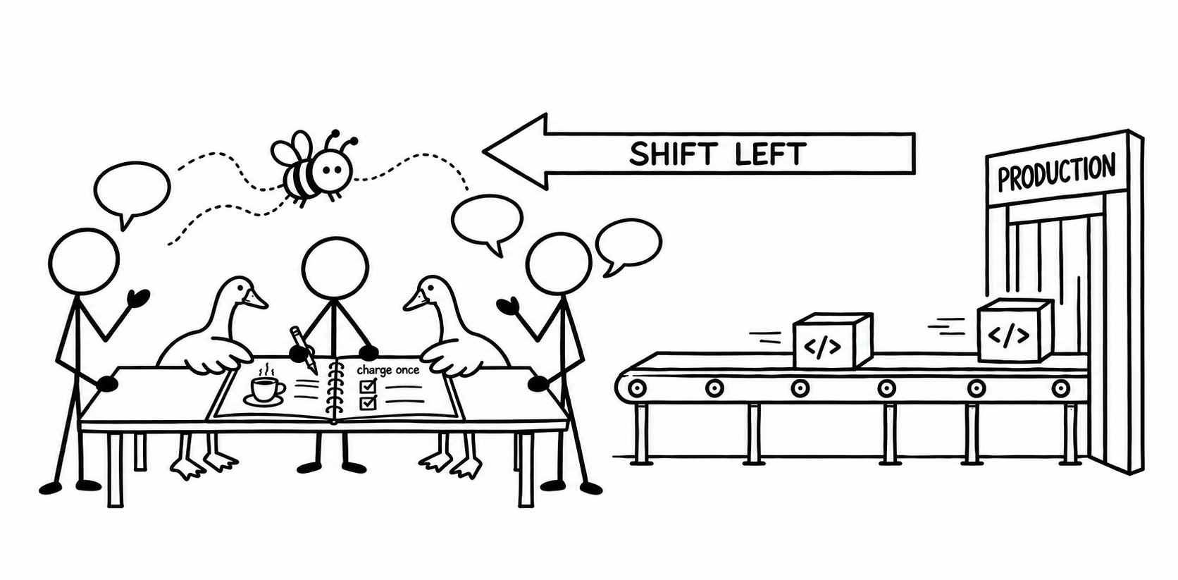
Get review before the code is written
Buzz / CoPlan
Notes:
As agents are able to take on more autonomy in the software development lifecycle, it’s critical that we choose agent-native platforms that bring review into the process before code is written.
That’s what we’re trying with our open source projects like Buzz and CoPlan. Sharing our agent’s sessions and inviting our teammates to participate earlier in the planning process allows our agents to build a more complete view of our systems, and de-risks the changes that get implemented downstream of our alignment.

Slide 27
Prioritize precision
over recall
Notes:
So, to summarize, how do we build a reviewer that prioritizes signal over noise, and prove that it’s something we can actually trust?
First, and most importantly: we have to build our ability to evaluate our reviewer against known good results. If we want to be able to trust it, we need to be able to put numbers on how often our reviewer is giving accurate results (which you measure with precision), and how often it’s missing things (which you can measure by recall). If you want people to pay attention to your reviewer’s findings, you must prioritize precision over recall. No matter how thorough your reviewer is, if a significant amount of findings are bogus or harmful, you’ll quickly lose the attention of your operators.

Slide 28
Give your agents
the big picture
Notes:
Next, as the models improve, our job as builders is shifting from reviewing every line of code to ensuring that we’re providing the appropriate context to align our agents with the big picture of what we’re working to accomplish. Once we’ve made our preferences and goals legible to our agents, they are able to make local decisions more mindfully. Even as the models get better, maintaining an adversarial reviewer that double checks your agents’ output allows you to contain new risks being introduced.

Slide 29
Build alignment
before the code is written
Notes:
Finally, as code verification becomes more automated, it’s vital that we we bring more of our coworkers into our agent sessions to build alignment earlier, before the code has been written. Using agent-native platforms to plan allows them to build a more complete model of your world, and makes it easier to trust the work once it’s complete.

Slide 30
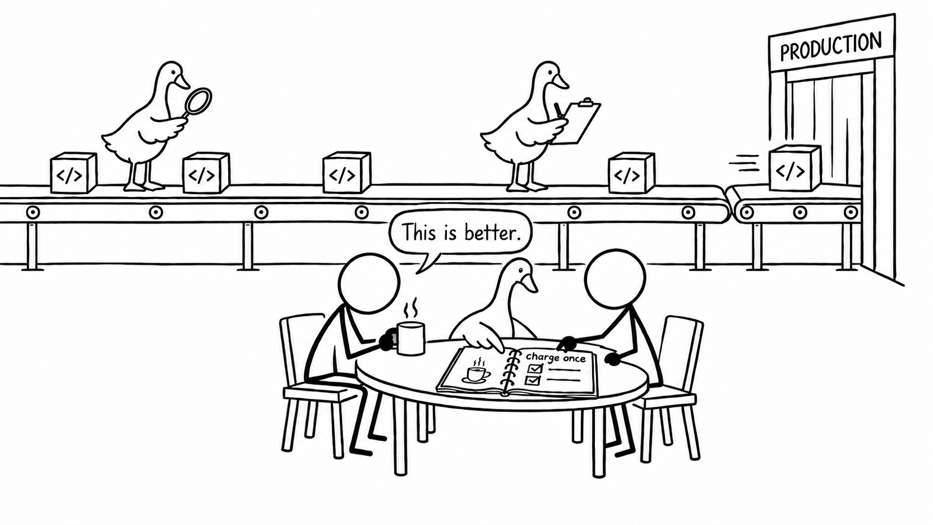
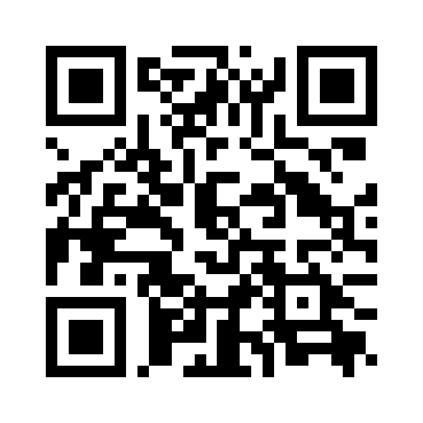
joahg.dev/cut-the-noise
Notes:
I am so grateful for the chance to be working alongside so many brilliant engineers at the frontier of our industry. I have learned so much about the way to build agentic systems in production, and none of this would’ve happened without my team and a whole bunch of people eager to work in the open and share what they’re learning.
All of my slides, along with links to each of the projects and papers that I referenced are available on my website. I would be thrilled to discuss this topic at any length if you’d like to find me afterwards or email me.
I appreciate you all for being here - Thank you for your time!

